Slide 1

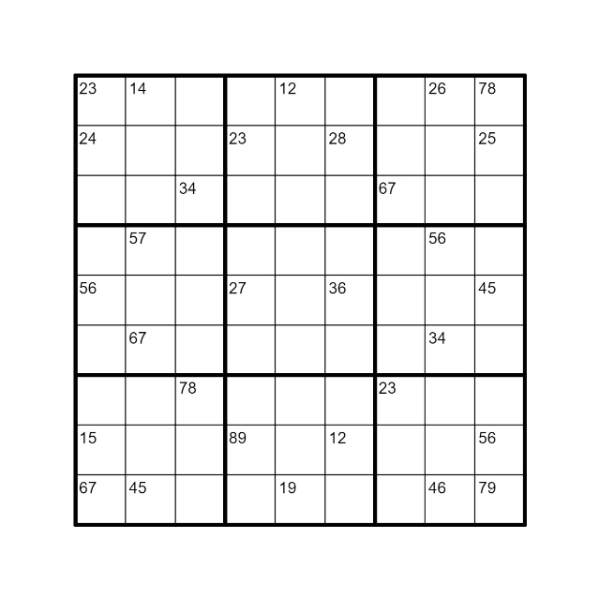

Sudoku Solver Visualizer
The Sudoku Solver Visualizer is an interactive Java application designed to solve Sudoku puzzles while providing a real-time visual representation of the solving process. This project serves multiple purposes:
Shivam
Reg no. : 12222559

Slide 2

Algorithmic Demonstration
1
Backtracking Algorithm
2
Educational Tool
The core of the project is a backtracking algorithm implementation for solving Sudoku puzzles. By visualizing this algorithm in action, the application offers an intuitive understanding of how backtracking works in practice.
This makes it an excellent educational tool for computer science students learning about algorithmic problem-solving techniques.
3
Problem-Solving Techniques
4
Constraint Satisfaction
The application demonstrates how backtracking is used to systematically explore potential solutions, backtracking when it reaches an invalid state.
The project illustrates how backtracking is a powerful technique for solving constraint satisfaction problems, where solutions must meet specific criteria.

Slide 3

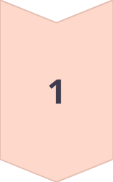
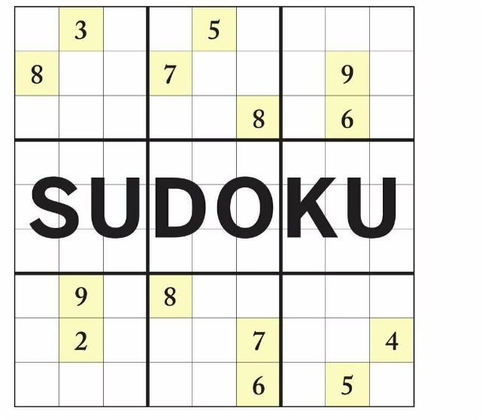
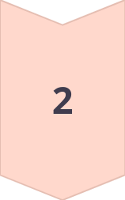

Backtracking Approach
Try a Number
Place a number in an empty cell and check if it's valid.
Backtrack
If the number is invalid, remove it and try a different number.
Solve Recursively
Repeat the process until a valid solution is found.

Slide 4

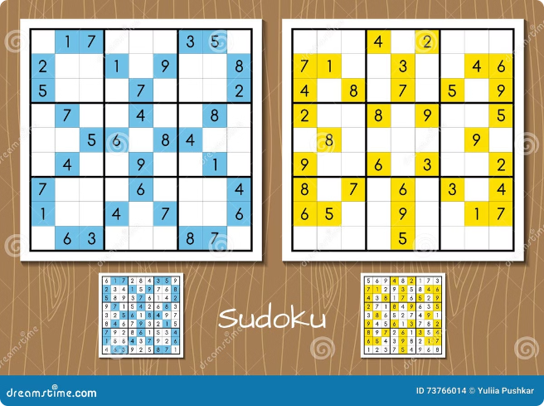
Interactive Visualization
1
Number Placements
Users can watch as the program attempts different numbers, backtracks when it reaches an invalid state, and eventually finds the correct solution.
2
Color-Coding
The color-coding of cells (green for placed numbers, red for backtracked attempts) provides immediate visual feedback on the algorithm's progress.
3
Real-Time Feedback
This real-time feedback helps users understand the algorithm's decision-making process and the logic behind each step.

Slide 5
Java Swing Utilization
GUI Components
JFrame
JLabel Array
The project showcases the use of Java Swing for creating graphical user interfaces. It demonstrates how to create a grid-based layout, use JLabels as interactive elements, and update GUI components in real-time based on backend logic.
The main window uses a JFrame, offering a familiar environment for users across different operating systems.
Each cell in the Sudoku grid is represented by a JLabel, allowing for dynamic updates of numbers and colors.

Slide 6

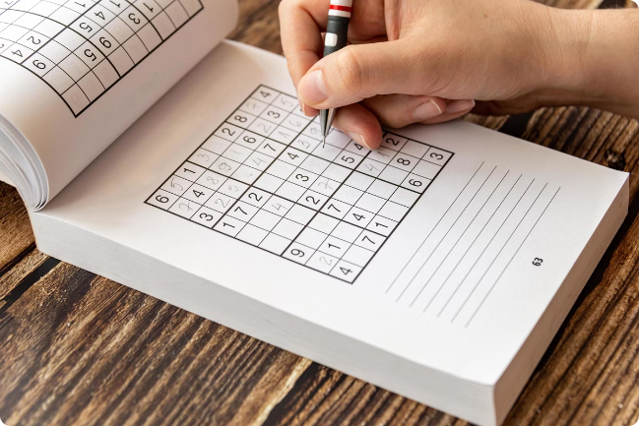
Problem-Solving Insight
Logical Steps
For Sudoku enthusiasts, the visualizer offers insight into the logical steps required to solve complex puzzles.
Strategies
It can help users understand the strategies employed in Sudoku solving, potentially improving their own solving skills.
Visual Representation
The visual representation of the solving process provides a clear and intuitive understanding of the logic behind each step.

Slide 7

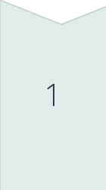
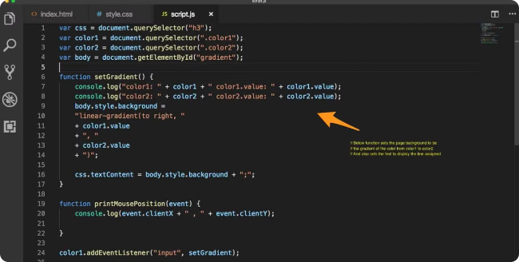
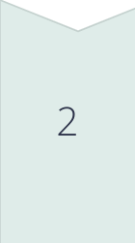
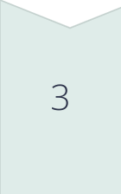
Extensible Framework
9x9 Grids
While the current implementation focuses on 9x9 Sudoku grids, the structure of the code allows for potential extensions.
Different Grid Sizes
This could include handling different grid sizes, incorporating user input, or implementing additional Sudoku-solving algorithms for comparison.
Future Development
The modular design of the code makes it easy to add new features and adapt to different requirements.

Slide 8

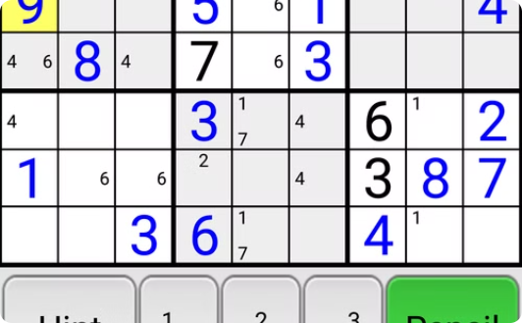
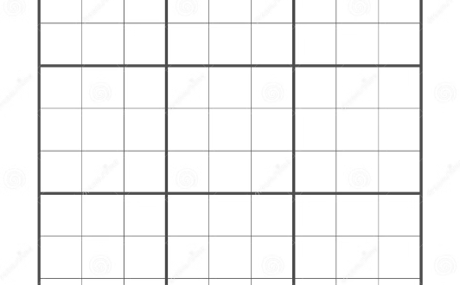
Color-Coded Cell Updates
Green
Red
Light Gray
Indicates a number that has been successfully placed.
Shows cells where the algorithm has backtracked.
Represents the initial state and final solution.

Slide 9

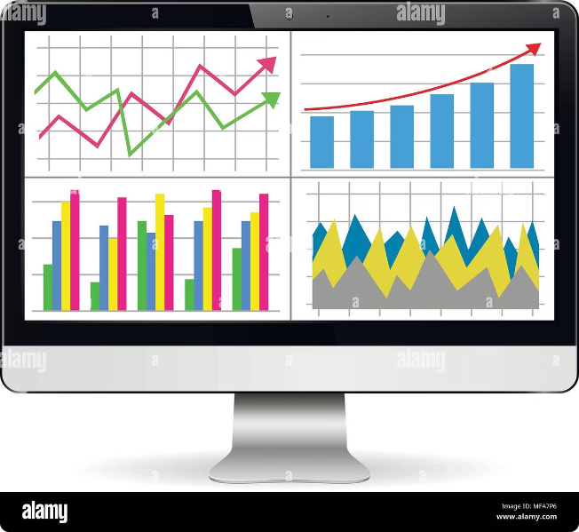
Performance Visualization
Efficiency
The application indirectly demonstrates the efficiency (or potential inefficiency) of the backtracking algorithm.
Difficulty
Users can observe how the algorithm performs on puzzles of varying difficulty, providing a tangible sense of algorithmic complexity.
Visualization
The visualization helps users understand how the algorithm's performance is affected by the complexity of the puzzle.

Slide 10





Multidisciplinary Integration
Algorithm Implementation
GUI Design
Event Handling
Graphics Manipulation
The project demonstrates how to create a user-friendly interface that effectively communicates the solving process.
The application handles events such as user input and updates the GUI accordingly.
The project utilizes basic graphics manipulation techniques to create the visual representation of the solving process.
This project integrates various aspects of software development, including algorithm implementation, GUI design, event handling, and basic graphics manipulation.

Slide 11

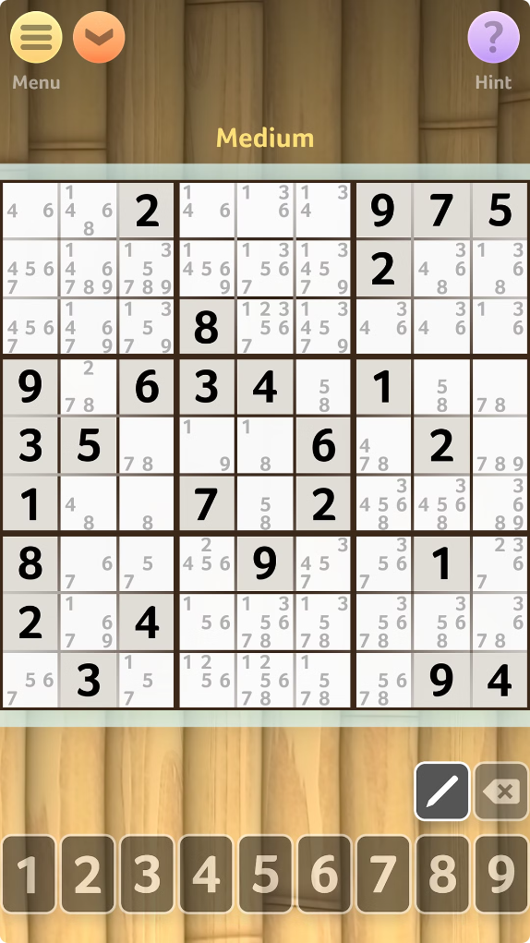



Real-World Applications
Puzzle Solving
The solver can be used to solve Sudoku puzzles of varying difficulty levels.
Logic Training
The visualizer can be used as an educational tool to teach logical thinking.
Algorithm Demonstration
The program showcases the power of backtracking algorithms in problem-solving.

Slide 12
Real-World Applications
Puzzle Solving
The solver can be used to solve Sudoku puzzles of varying difficulty levels.
Logic Training
The visualizer can be used as an educational tool to teach logical thinking.
Algorithm Demonstration
The program showcases the power of backtracking algorithms in problem-solving.

